Slide 1


Minor Project
Title: Railway Enquiry System (RES)
Project No. 60
Members (CSE)
1.Amarjeet Singh (161B027)
2.Amit Kumar(161B028)
3.Satyam Prakash (161B201)
Project Guide
Mr. Neelesh Kumar Jain

Slide 2
Narrative
RES is a web based application that is useful in enquiring the status of reservation, On the basis of PNR number and other input from the user.
In this web based application users can also check train route, day availability Live status and can also check fare between two cities by entering the required queries.

Slide 3
Purpose
The purpose of RES is to facilitate users to check or enquire their Railway related queries instantly on a click.
Scope
RES offers basic services to the users like Indian Railways and NTES(National train Enquiry System).

Slide 4
Software Requirements:
With time, more requirements might be added to account for the development of this project. Like reservation of tickets, confirmation probability of waiting list .
Sublime Text Editor.
Google Chrome.
Hardware Requirements :
Processor: Pentium III or next version
Hard disk drive: 40 GB or more
RAM: 512 MB or more
Cache: 512 kb or more

Slide 5
Technique Used
We have used API(Application Programmable Interface) to get information from Indian Railways regarding Live Train Status, PNR Status, Train Schedule, Seat Availability, Fare Enquiry ,Trains between stations, cancelled trains and reschedule trains.
The getJSON() method is used to get JSON data using an AJAX HTTP GET request

Slide 6
Languages Used
HTML
CSS
JavaScript
Bootstrap
JavaScript Object Notation (JSON)
Asynchronous JavaScript and XML (AJAX)

Slide 7
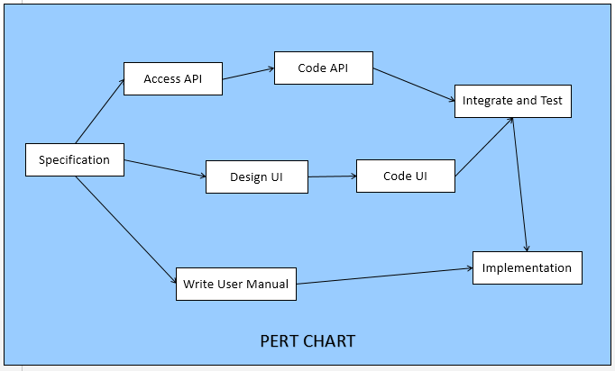
Pert Chart

Slide 8
Use Case Diagram
Use case- Represents the specification of a sequence of actions, that a system can perform, interacting with actors of the system.
Actors- Entity that interacts with the system and is always benefitted by the system.
Users- Requesting for information.
Administrator- Providing the information.

Slide 9
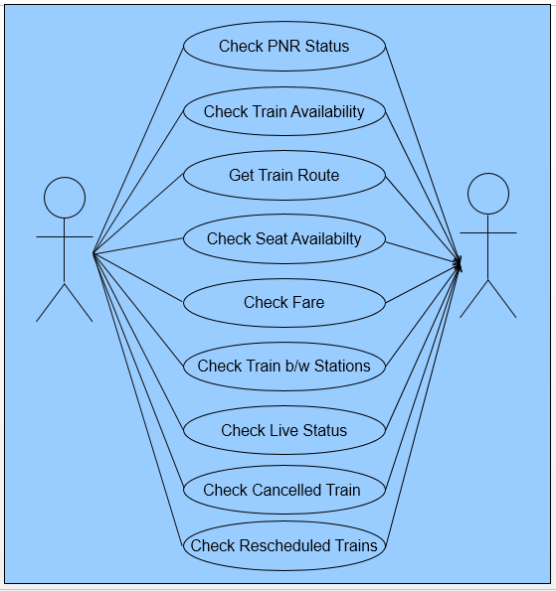
Use Case Diagram

Slide 10
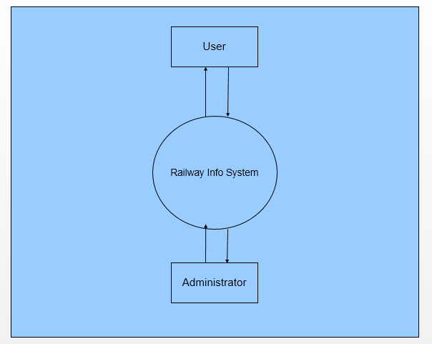
Data Flow Diagram (Level 0)

Slide 11
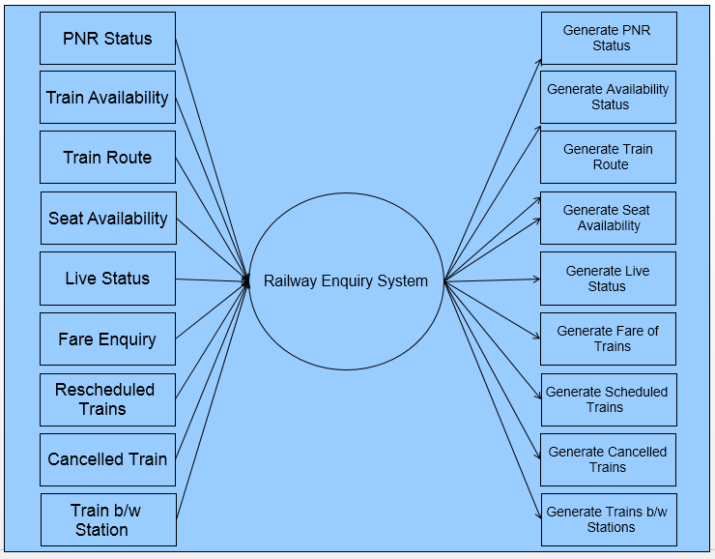
Data Flow Diagram (Level 1)

Slide 12
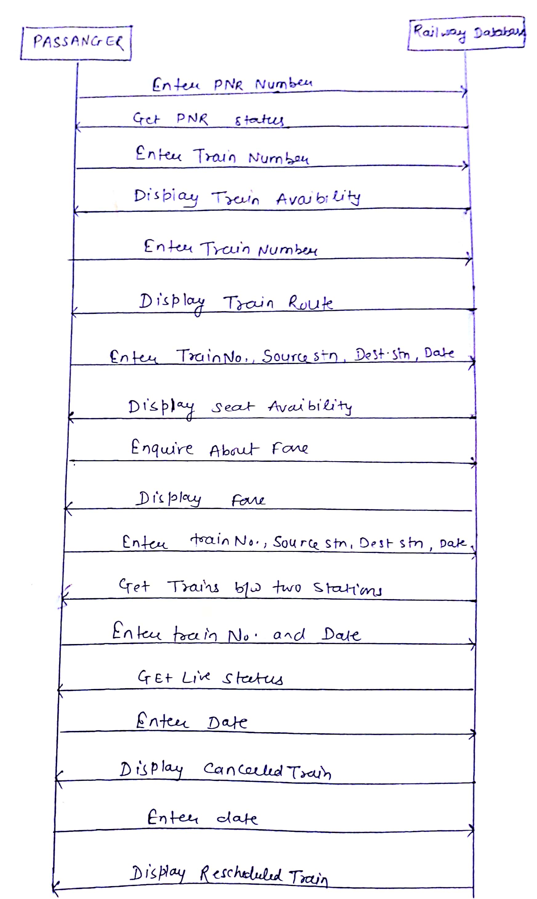
Sequence Diagram

Slide 13
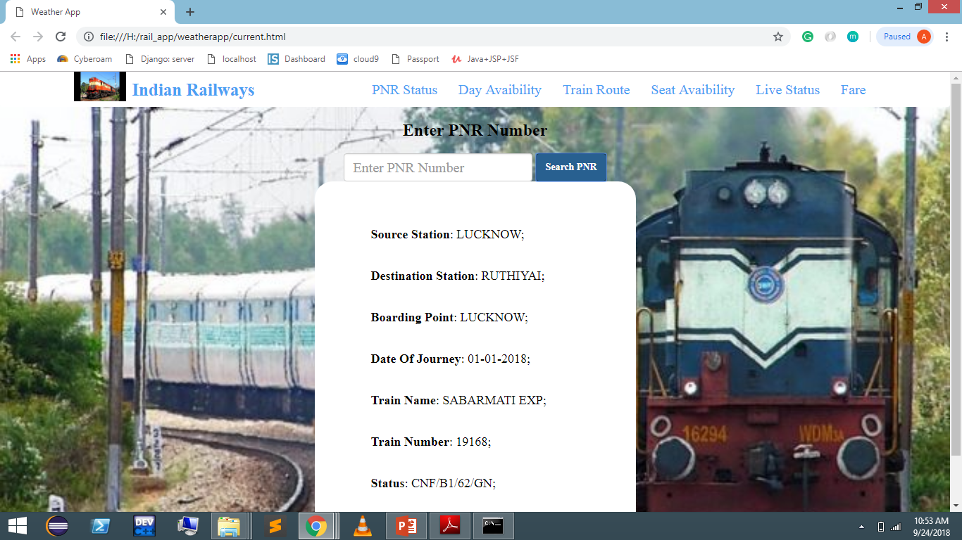
PNR Status: This function allows the user to get their PNR status by entering the PNR number.

Slide 14
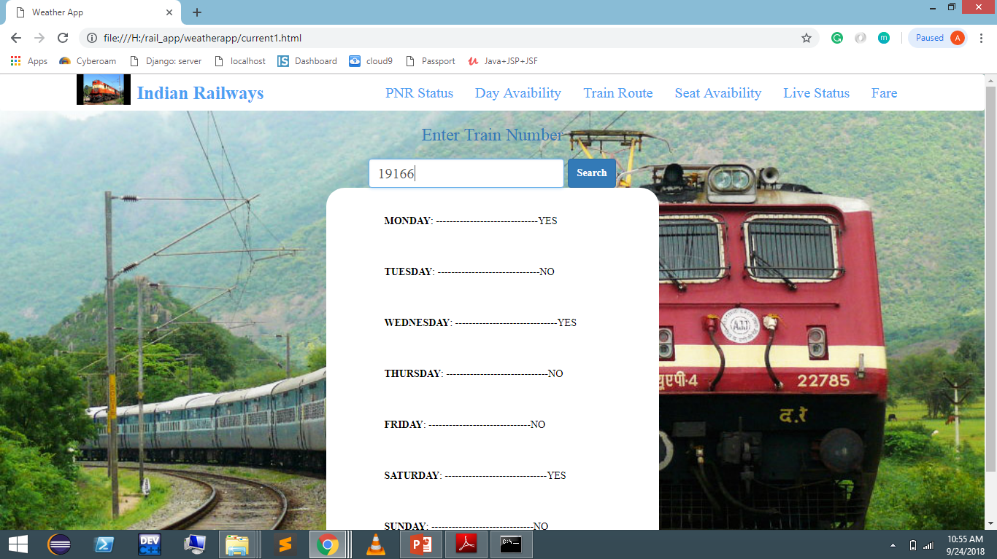
Day Availability: This function allows the users to search for train that are available at particular Day.

Slide 15
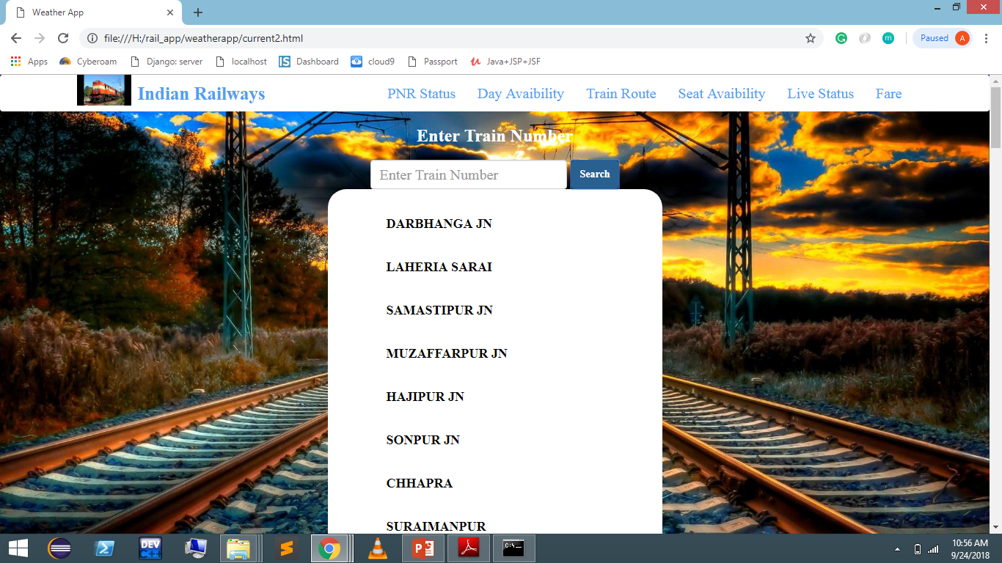
Train Route: This function allows the users to get the route of train between two stations.

Slide 16
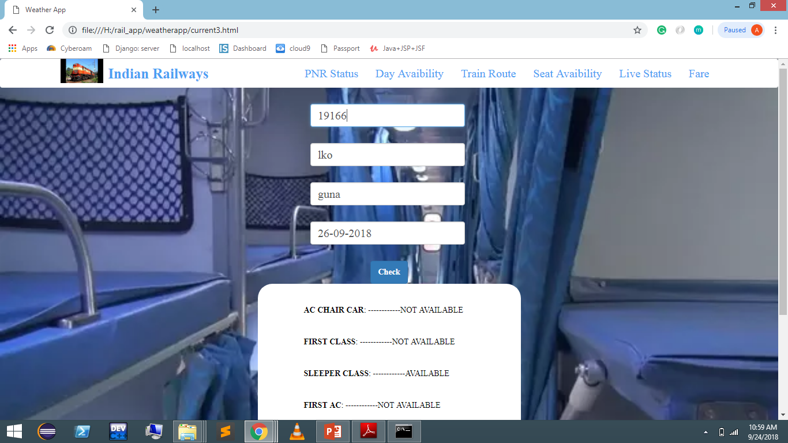
Seat availability: This function allows the users to know the available seats in particular train

Slide 17
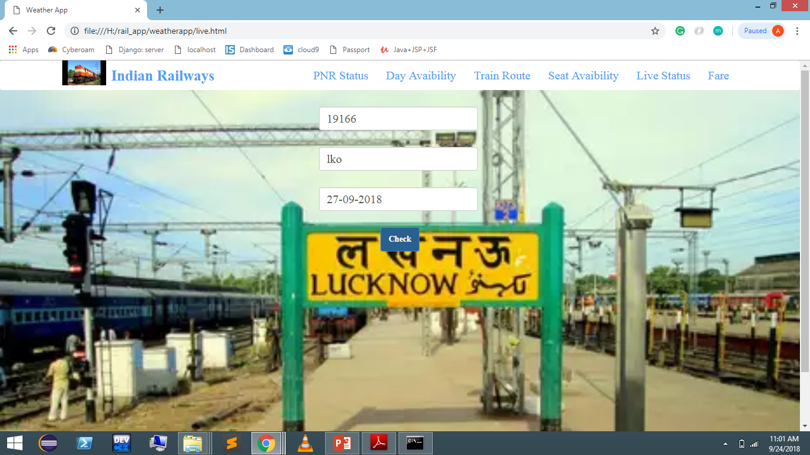
Live Status: This function allows the users to check the live status of Train

Slide 18
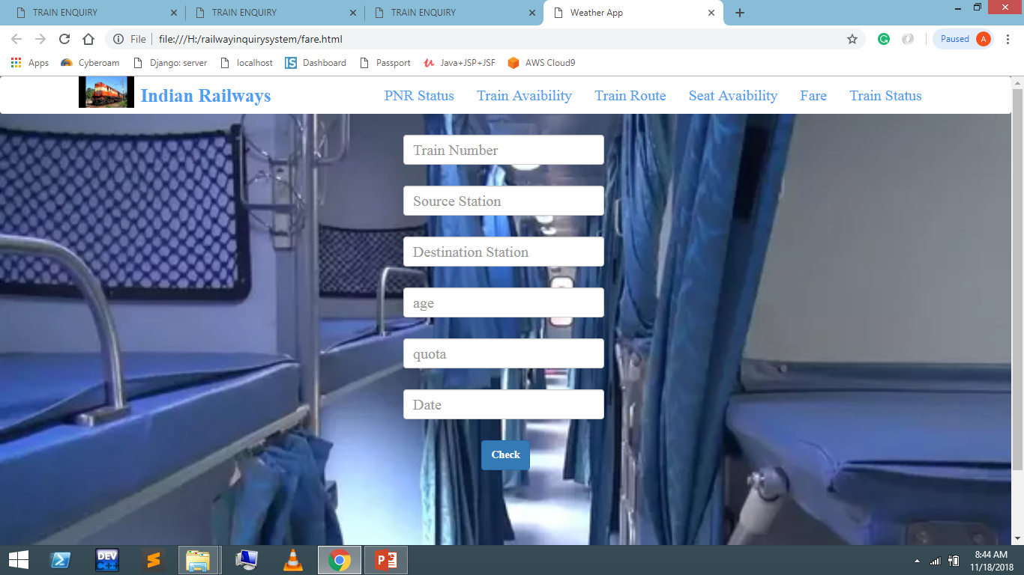
Fare: This function allows the users to get the fare of all the available classes along with concession for children as well as senior citizen

Slide 19
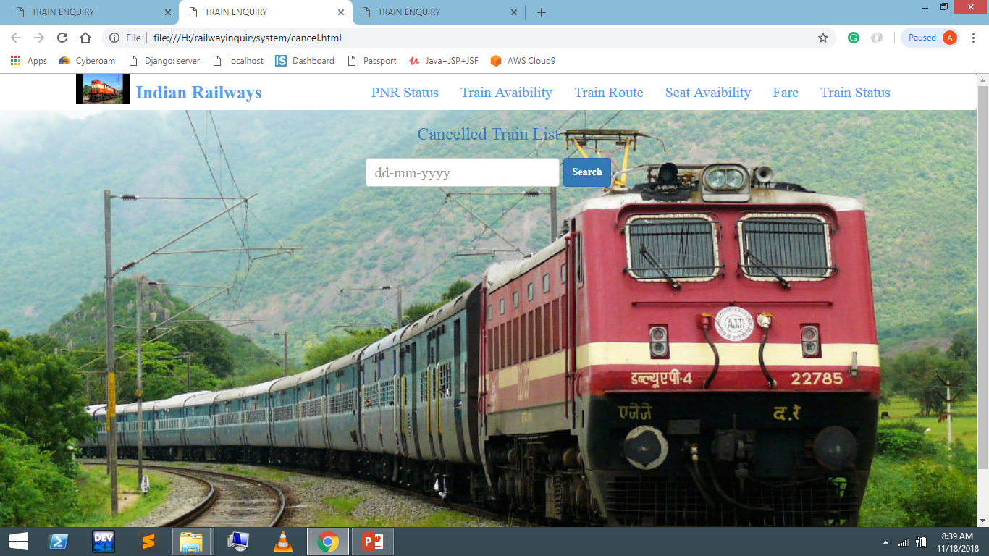
Cancelled Trains: This function allows the users to get the list of all cancelled trains on a particular date by entering the date.

Slide 20
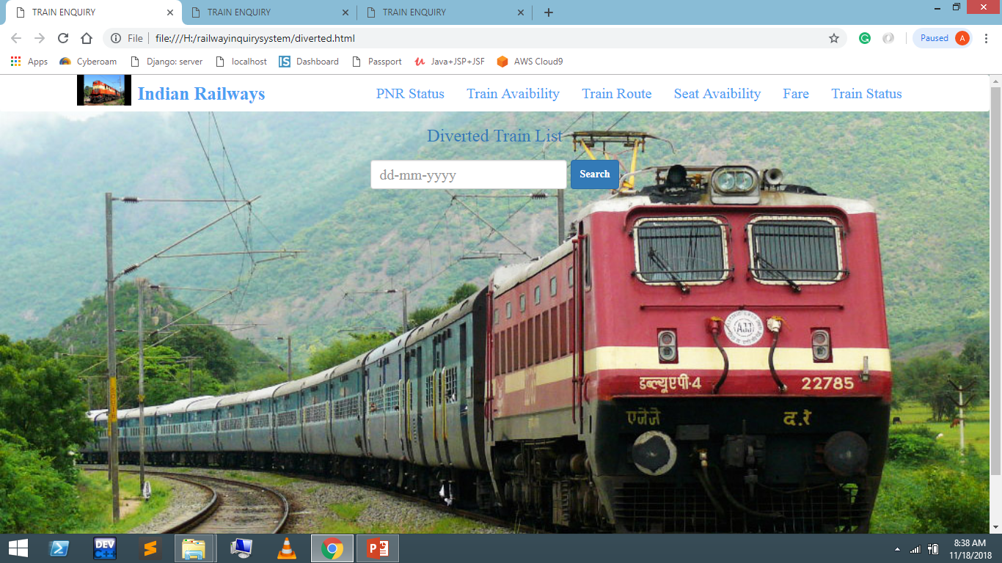
Diverted Trains: This function allows the users to get the details of diverted trains.

Slide 21
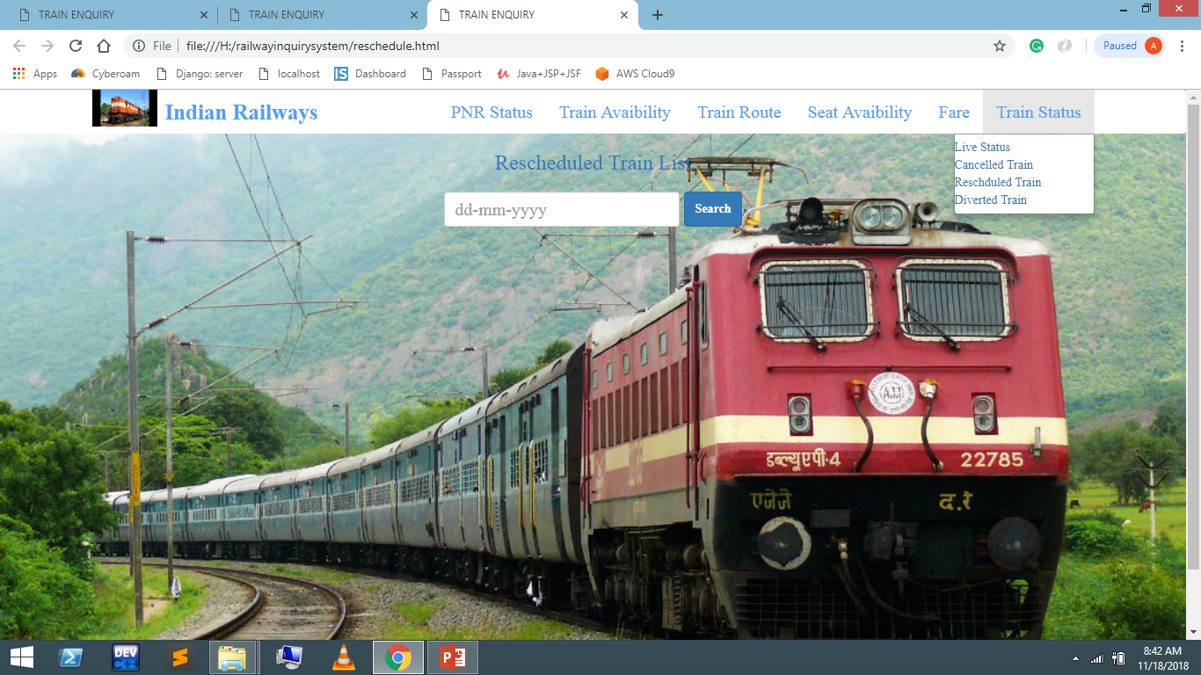
Rescheduled Trains: This function allows the users to get the list of trains that are Rescheduled.

Slide 22
Bibliography
W3school
(https://www.w3schools.com/js/js_ajax_intro.asp)
Edx
https://www.edx.org/course?subject=Computer%20Science
Google
(https://www.google.com)
API
(https://api.railwayapi.com)

Slide 23
Thank You!!

